Slide 1
Micro Services
With Spring Boot

Slide 2
Introduction
Review of our app
Identify its style
Advantages and disadvantages
Microservices Pattern
Hands-on
Create a API layer
Call business service using REST template (hardcoded)
Uline libraries
Common REST libraries for developers.
Goal – Able to create a spring application from the scratch.

Slide 3


Architecture
Application
User Interface
jar
code
Business Logic
build
deploy
Developer
Data Layer
machine
DB
Monolithic

Slide 4
Pros and Cons
Pros
Simple to develop.
Simple to test. You can do end-to-end testing by simply launching the application and testing
Simple to deploy. Just one jar that could be deployed.
Cons
Application can grow too large as functionalities increase .
For each update, we have to redeploy
Impact of change is usually not clear as the application grows big and complex
Reliability. A bug in a module (eg memory leak) can potentially bring down the entire process.

Slide 5
Microservices
Idea is to split the application into a set of smaller, interconnected services
Each microservices is a small application that has its own domain specific business logic.
Pros :
Enables each service to be developed independently by a team that is focused on that service.
Enables deploy independently. So continuous deployment is possible.
Enables service to be scaled independently.
Cons:
Challenges of a distributed system.
Might be difficult to implement changes that span multiple services.

Slide 6
Try It! Create Api Layer
Let’s create another Spring Boot REST service but with no database
Create a Spring boot with WEB dependency
Step 1 – Add spring boot parent
The spring-boot-starter-parent project is a special starter project – that provides default configurations for our application and a complete dependency tree to quickly build our Spring Boot project.
Step 2 – Add spring boot starter web as dependencies
Create Application Class and annotate with @SpringBootApplication.
Create a model Person.
Create a PersonController
Get /api/persons -🡪 returns list of Person Objects
Create a PersonService
Return a dummy list

Slide 7
Layered Architecture of Services
Services
Controller
Service
Client
HTTP url + Method
Request Mapping
Business Logic
REST Call
JSON
Model
Model
Model <-> JSON
JSON

Slide 8
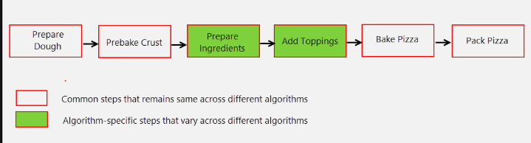
Pattern Alert !
In many frameworks, a significant portion of the code is boilerplate code.
The template method pattern is a technique that defines the steps required for some action, implementing the boilerplate steps, and leaving the customizable steps as abstract.

Slide 9
REST Template
Create applications that consume RESTful Web Services
Handles boilerplate code
Creating a URL object and opening the connection
Configuring the HTTP request
Executing the HTTP request
Interpretation of the HTTP response
Converting the HTTP response into a Java object
Exception handling
Notes:
When using RestTemplate all these things happen in the background and the developer doesn’t have to bother with it.

Slide 10
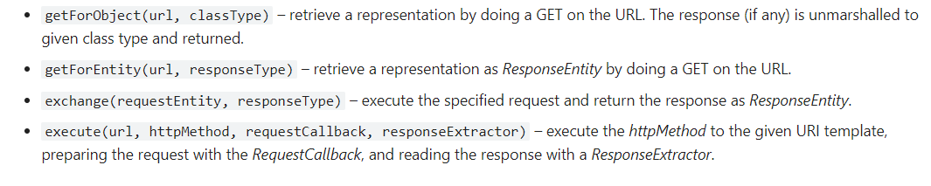
RestTemplate Methods
There are also methods for PUT, POST and DELETE
RestTEmplate doc
Notes:
public List<Person> getPersons(){ RestTemplate restTemplate = new RestTemplate(); List<Person> persons = restTemplate.getForEntity("http://localhost:8081/persons",ArrayList.class).getBody(); return persons; }
// Move Rest template into application
@Bean public RestTemplate getRestTemplate() { return new RestTemplate(); }

Slide 11
Lets use getForEntity
public List<Person> getPersons(){ RestTemplate restTemplate = new RestTemplate(); List<Person> persons = restTemplate.getForEntity("http://localhost:8081/persons",ArrayList.class).getBody(); return persons; }
// Move Rest template into application
@Bean public RestTemplate getRestTemplate() { return new RestTemplate(); }
Notes:
public List<Person> getPersons(){ RestTemplate restTemplate = new RestTemplate(); List<Person> persons = restTemplate.getForEntity("http://localhost:8081/persons",ArrayList.class).getBody(); return persons; }

Slide 12
@Autowired vs @Bean
@Bean tells Spring 'here is an instance of this class, please keep hold of it and give it back to me when I ask’.
@Autowired says 'please give me an instance of this class, for example, one that I created with an @Bean annotation earlier’.
In short @Bean is producer and @Autowired is consumer

Slide 13
What’s wrong
URL is hardcoded here
what if port/server changes ?
Application Scaling.
Notes:
// Move Rest template into application
@Bean public RestTemplate getRestTemplate() { return new RestTemplate(); }
And Autowire Rest template

Slide 14
Service Discovery
lookup
Registry
Client
Registers
2
1
3
MicroServices
Notes:
There are two

Slide 15
Client side Lookup
lookup
Registry
Location info
Client
Registers
REST Call
2
1
3
MicroServices
Notes:
Similar to “Google Search”
Where the client look up for a phone number for a business in the google, and get the details
Now with the phone number, we call directly the services

Slide 16
Server side lookup
REST Call
Registry
Client
REST Call
Registers
2
1
3
MicroServices
Notes:
Similar to calling a person in a company via reception
You don’t know/care what the extension, but the receptionist routes you to the right person you are looking for.

Slide 17
Hashicorp Consul pattern
Give me locations of services
Consul
List of service location
PSA
Registers
REST Call
Call with physical end-point
2
1
3
Person service

Slide 18
Consul
Service Discovery
to automatically register and unregister the network locations of service instances
Health Checking
to detect when a service instance is up and running
KV store
Key value store. to ensure all service instances use the same configuration
Multi Datacenter
Notes:
<dependency>
<groupId>org.springframework.cloud</groupId>
<artifactId>spring-cloud-starter-consul-config</artifactId>
<version>2.0.1.RELEASE</version>
</dependency>
@EnableDiscoveryClient

Slide 19
What are other challenges ?
Managing microservices
Now we have hundreds of services running with multiple instances
and zones.
Logging, monitoring and debugging
The system becomes highly fragmented and a stronger need arises for centralized monitoring and logging
Fault Tolerance and Resiliency
Too many services and multiple point of failures.
Deployment Challenges
The product may need coordination among multiple services, which may not be as straightforward as deploying a WAR in a container.

Slide 20
What are other challenges ?
Security
With tons of communications happening between the services
it is really important to share information only with the right service.
Version management
Services within the same organization using multiple versions of libraries causing issue.

Slide 21
Our answers
Managing microservices and deployment challenges
Jenkins CI/CD pipeline
Custom built UOPS site.
Logging Monitoring and debugging
Kibana
Dynatrace
Fault Tolerance and Resiliency
Timeouts
Circuit break pattern
Security
Java Web Token (common-security)
Version Management
Common base libraries

Slide 22
Fault Tolerant and Resiliency
With too many micro services and components and introduced now we
Have multiple point of failures.
Expect the failure to occur
Keep going if something we depend on is broken
Recover quickly
Fault tolerant and resiliency go hand in hand

Slide 23
Fault Tolerant and Resiliency
Timeouts
Default timeout on our services are 5s.
Retries
Sometime we could do 3 retries if not expected result .
Circuit Breaker Pattern
Netflix’s Hystrix library provides an implementation of the circuit breaker pattern.

Slide 24
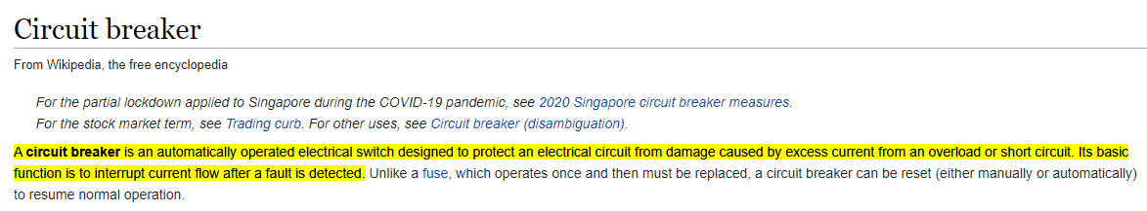
Circuit breaker
This explanation kind of matches with the expectation for a fault tolerant and resiliency system.

Slide 25
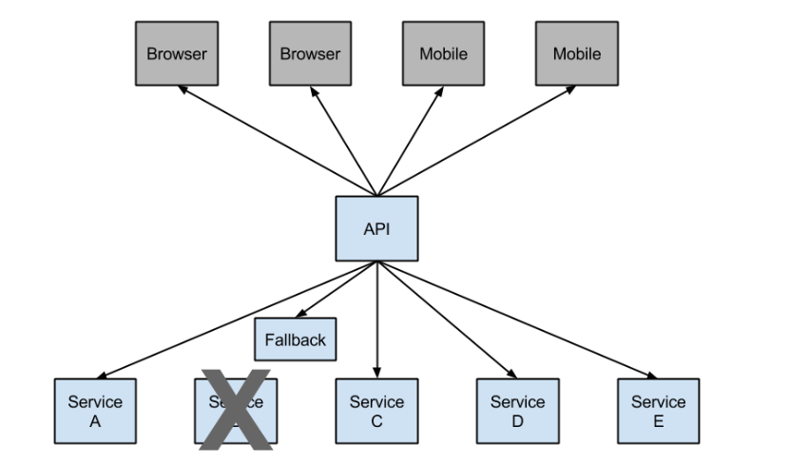
Circuit breaker

Slide 26
Uline Libraries
Recap :
Developed Business Service with resource layer
Developed API Layer.
Communication
First we call directly
Introduced Consul and call through service discovery.
Now, Lets look into what all other Libraries developed by Uline Engineering team that are for re-use . Over to Common Libraries portion

Slide 27
Lifecycle of your code
Connect to Git from Intellij
Git Branching
Naming conventions – dev, feature, release.
Commit
PR creation
Code Review process
Best Practices
Master branch merge and Jenkins pipeline.
Regression scripts and sonarqube analysis.
Urban Code Deploy
Uops services and health check

